Slide 1

Smart Water Bowl For Pets
Exam project for the 2022/23 Iot course at Unibo

Slide 2
Introduction
- A common problem for pet owners is to provide fresh water to their animal(s);
- Additionally, during summer season the water consuption is generally greater, and pet owners have to refill the bowl more frequently;
- For these reasons, the smart water bowl shall help pet owners by alerting them when the water level drops under a given threshold value;
- Also the smart bowl provides helpful insights about temperature and humidity;
- Two models also forecast the expected water level.

Slide 3
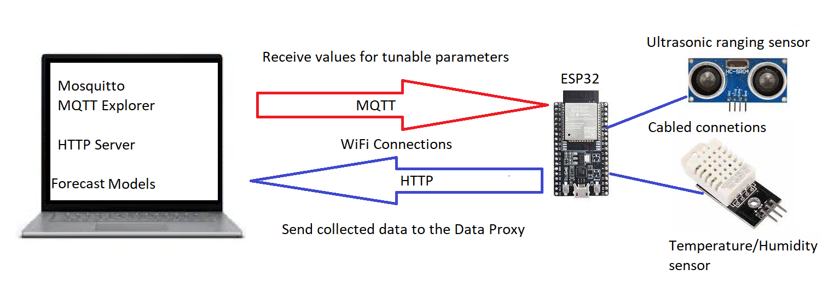
System Architecture
The system is divided in three main parts:
1) The ESP32 board that collects the relevant data;
2) The data pipeline that manages, store and makes the collected data available, and also allows the user to change the values for some parameters;
3) The forecasting models that predicts the water level based on collected data.

Slide 4
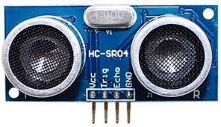
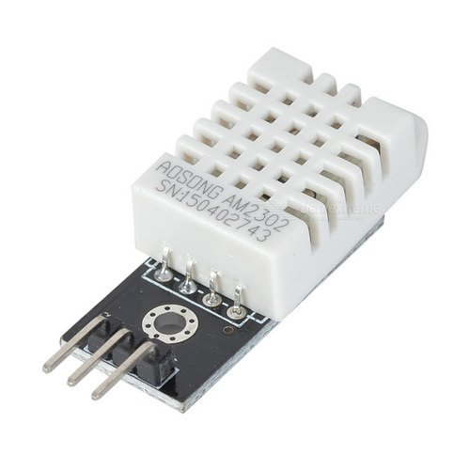
System Architecture
The device is made of an ESP32 board equipped with two sensors:
- HC-SR04: an ultrasonic ranging sensor that measure the distance between the sensor, on top of the bowl, and the water level;
- DHT22: a sensor that collects the temperature and humidity of air.

Slide 5
System Architecture
Data Pipeline
- MQTT
The user can change the values of some tunable variables as starting water level, threshold, sampling rate and the number of alarm events that need to be registered before sending an alert message to the user. This communication is managed using the MQTT protocol.
- HTTP
The data collected by the device is sent to a data proxy running on a PC through an HTTP post operation on a running server. Once the data arrive, it is stored in a database, and made available to other services as well.

Slide 6
System Architecture
The collected data is stored in an InfluxDB and made available for further data visualisation (Grafana) or for generating forecast predictions.
In particular, two different forecast models have been implemented:
- A simple model that estimates the water level assuming a costant decrease;
- An updated model that also implement the data about temperature and humidity in its predictions.

Slide 7
Implementation
ESP32
- The script code flashed on the ESP32 board has been developed in C++ using the ArduinoIDE;
- In order to measure the latency of the transimission, a connection to an NTP server is performed to get the epoch time;
- Once the board is connected to the WiFi, a tentative connection to the MQTT broker is performed. Once succesfull, the MQTT client subscribed to 4 topics;
- Lastly, the boards posts the collected to an HTTP endpoint after each measurement.

Slide 8
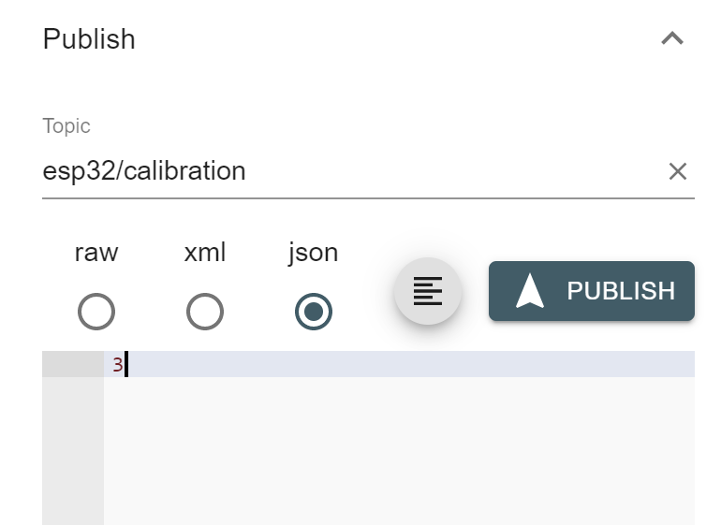
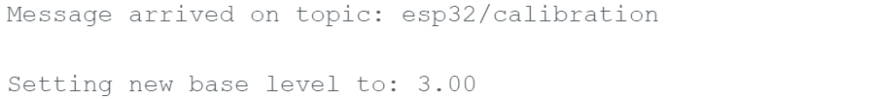
Implementation
MQTT
- The MQTT pub/sub communication is realised using Mosquitto Broker;
- MQTT Explorer acts as pub client/remote controller to change the value of: starting water level, threshold, sampling rate and alarm counter;
- Once a new value is published in one of the 4 topics (ex. esp32/calibration), the boards reads the message and sets the value of the corresponding parameter.

Slide 9
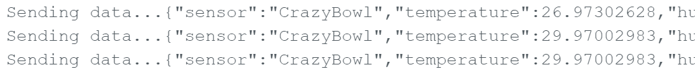
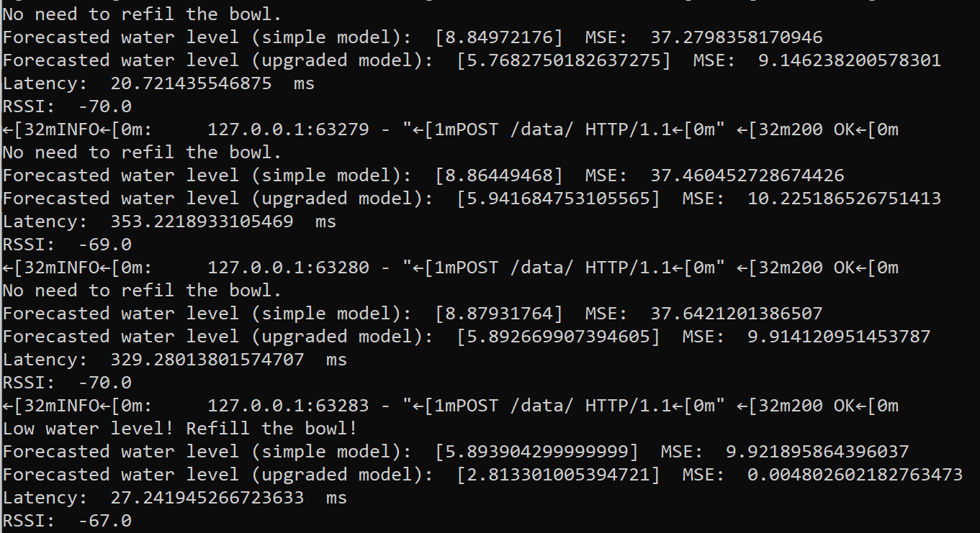
Implementation
HTTP
- I have decided to work with HTTP due to some issues arised with CoAP;
- The data collected by the sensors are then transfered to the data proxy through an HTTP post performed by the ESP32 client;
- The receiving endpoint has been developed using FastIP and Uvicorn;
- Once the data arrive, the system both saves a copy of the data in InfluxDB and makes the data available to the forecasting models.

Slide 10
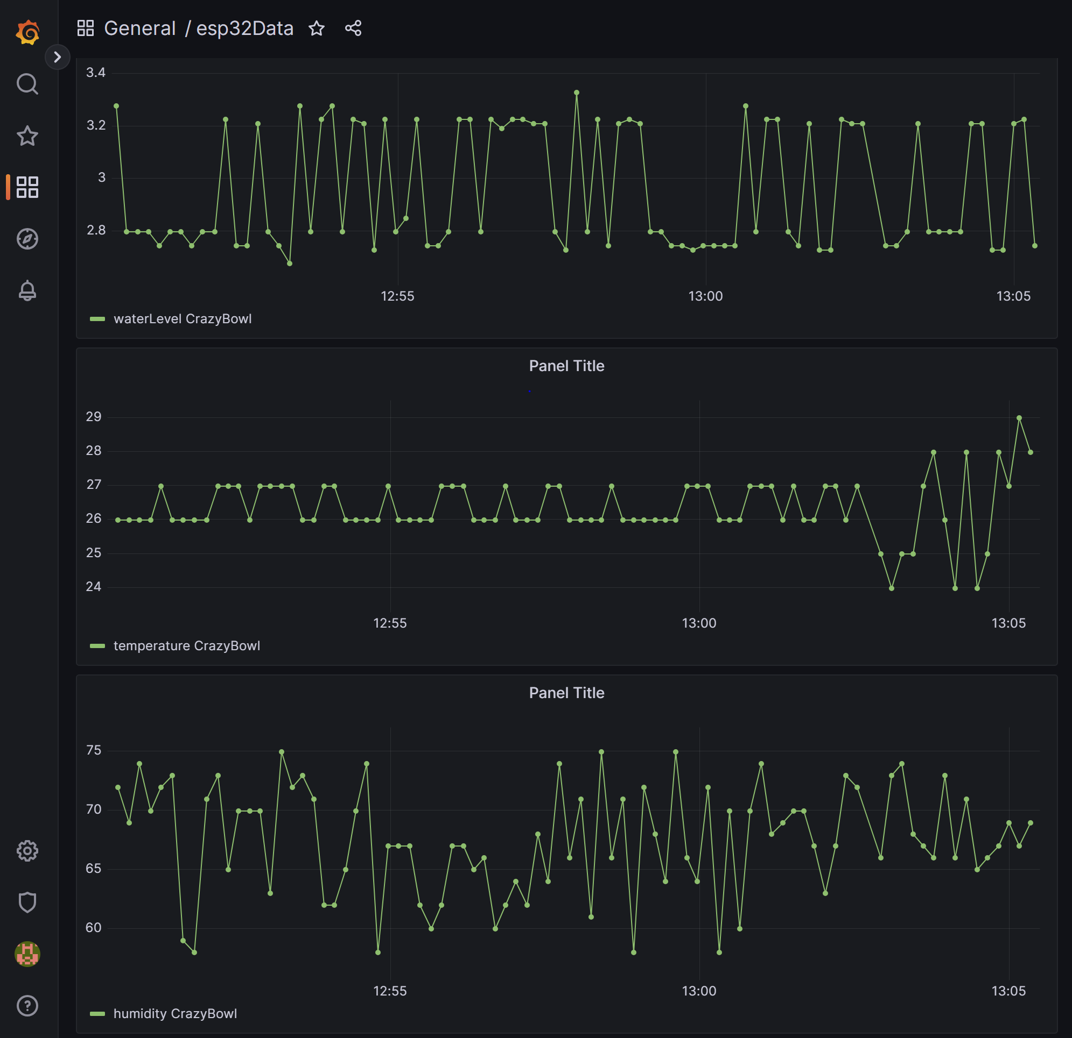
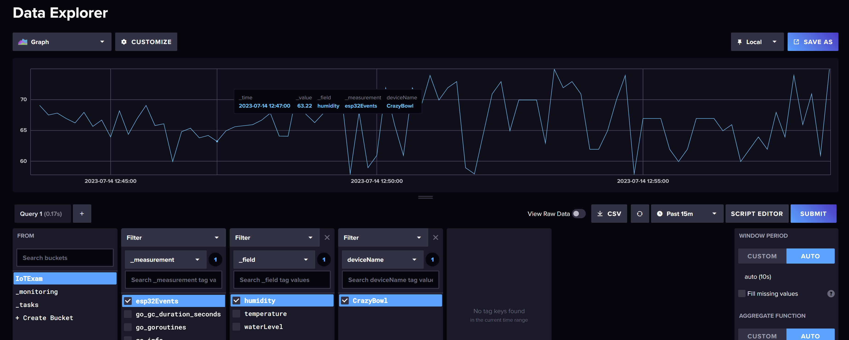
Implementation
InfluxDB and Grafana
- The data is stored using InfluxDB running in a Docker container,
- From here, data can be accessed by Grafana to show insight about water level, temperature and humidity.

Slide 11
Implementation
Forecasting Models
The collected data are used as input to forecast the water level. Two models have been implemented:
1) A simple model that predicts the water level by assuming a constant decrease of the water level over time;
2) An updated model that also takes into account the room temperature and humidity to predict the water level.

Slide 12
Results
The overall system performances have been evaluated by measuring the latency, i.e. the time required by system to transmit the data from the board to the data proxy. The measured latency ranged between 350 ms and 700 ms.
On the other hand, the models performances have been evaluated using Mean Square Error(MSE).

Slide 13
Discussion and Conclusion
While the system generally performed quite well, some issues with this solution may arise, for example:
- The distance sensor is very suscettible to vibrations and may limit the animal access to the bowl, or worst can be confused with a toy and chewed off. A possible solution is to replace the ranging sensor with a weight sensor to measure the water remaining in the bowl;
- The DHT22 sensor requires some time to warm up and prolonged usage can cause overheating and errors in the measurements;
- Some general problems with Windows and port forwarding;

Slide 14
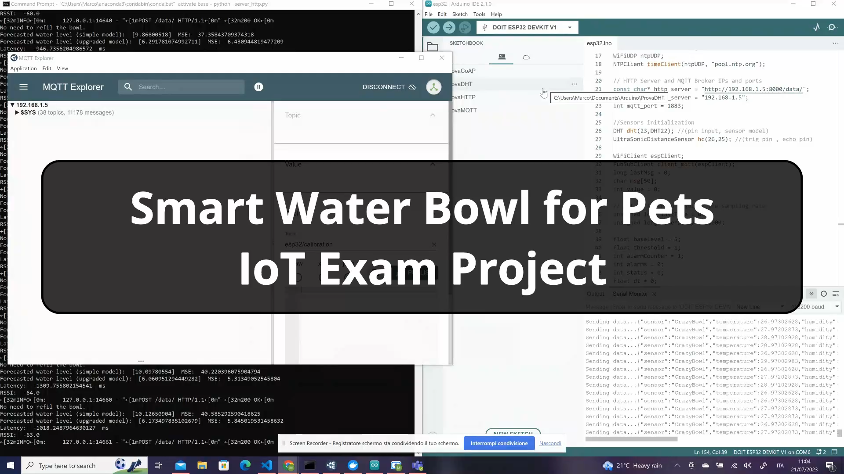
Video Demo

Slide 15
Thanks for your attention!
Any question?
Project repository on GitHub

Slide 16
HTTP vs CoAP
- Compared to HTTP, CoAP has fewer libraries available for implementation, making it easier to work with HTTP on the ESP32 and create an HTTP server. Also, integrating different libraries for CoAP might be challenging due to compatibility issues;
- CoAP binary message format, on the other hand, is more compact and efficient compared to HTTP's text-based format, especially on constrained devices. Still, the HTTP implementation worked with an acceptable latency;
- HTTP's set of methods is richer and geared towards general web applications;
- HTTP allows multiple concurrent requests over the same TCP connection, while CoAP (UDP) does not support concurrent requests.

Slide 17

Why Docker?
- My PC was a bit too «overcrowded»;
- Avoid dependencies conflicts with other programs/libraries;
- Influx container can be switch off when the systems is not running, instead of having Influx running all the time;
- Guide on how to run InfluxDB on Docker;
- Grafana, Mosquitto and other services can also be run on Docker containers.

